Slide 1

Project Social Distancing Simulator 2020 Group IT1A

Slide 2

Introduction
Chris Takacs / Back-end developer
Steffen Tourbier / Back-end developer
Robin Michael Visser / Front-end developer
Pepe Loperena Monzon / Front-end developer
Artem Yerzakovich / Front-end developer
Marek Stryjenski / Front-end developer

Slide 3
Overwiev
What is project Social Distancing Simulator 2020
Development
End results
What went well and what went wrong?
Q&A

Slide 4
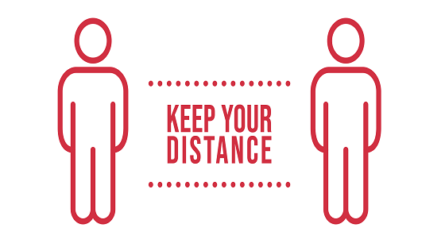
What is project Social Distancing Simulator 2020?

Slide 5
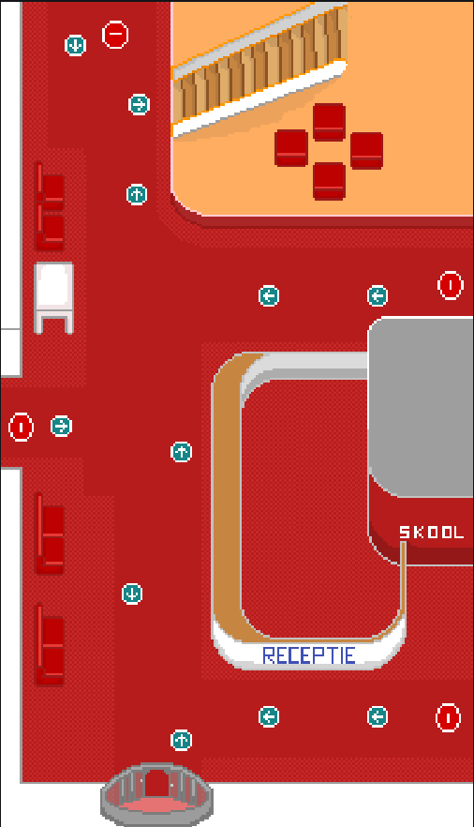
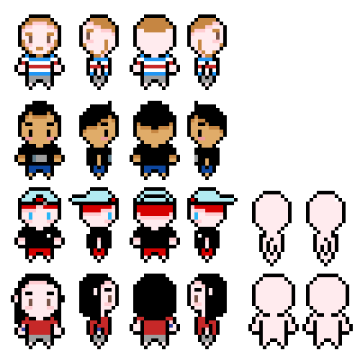
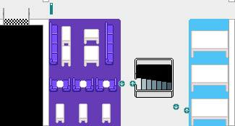
Development

Slide 6
End results

Slide 7
What went well and what went wrong?

Slide 8

Q&A

